Slide 1
Designing and Analysis of Algorithms Course Code: ECS 5101/CS514
Dr Rahul Mishra
IIT Patna
Lecture 22

Slide 2
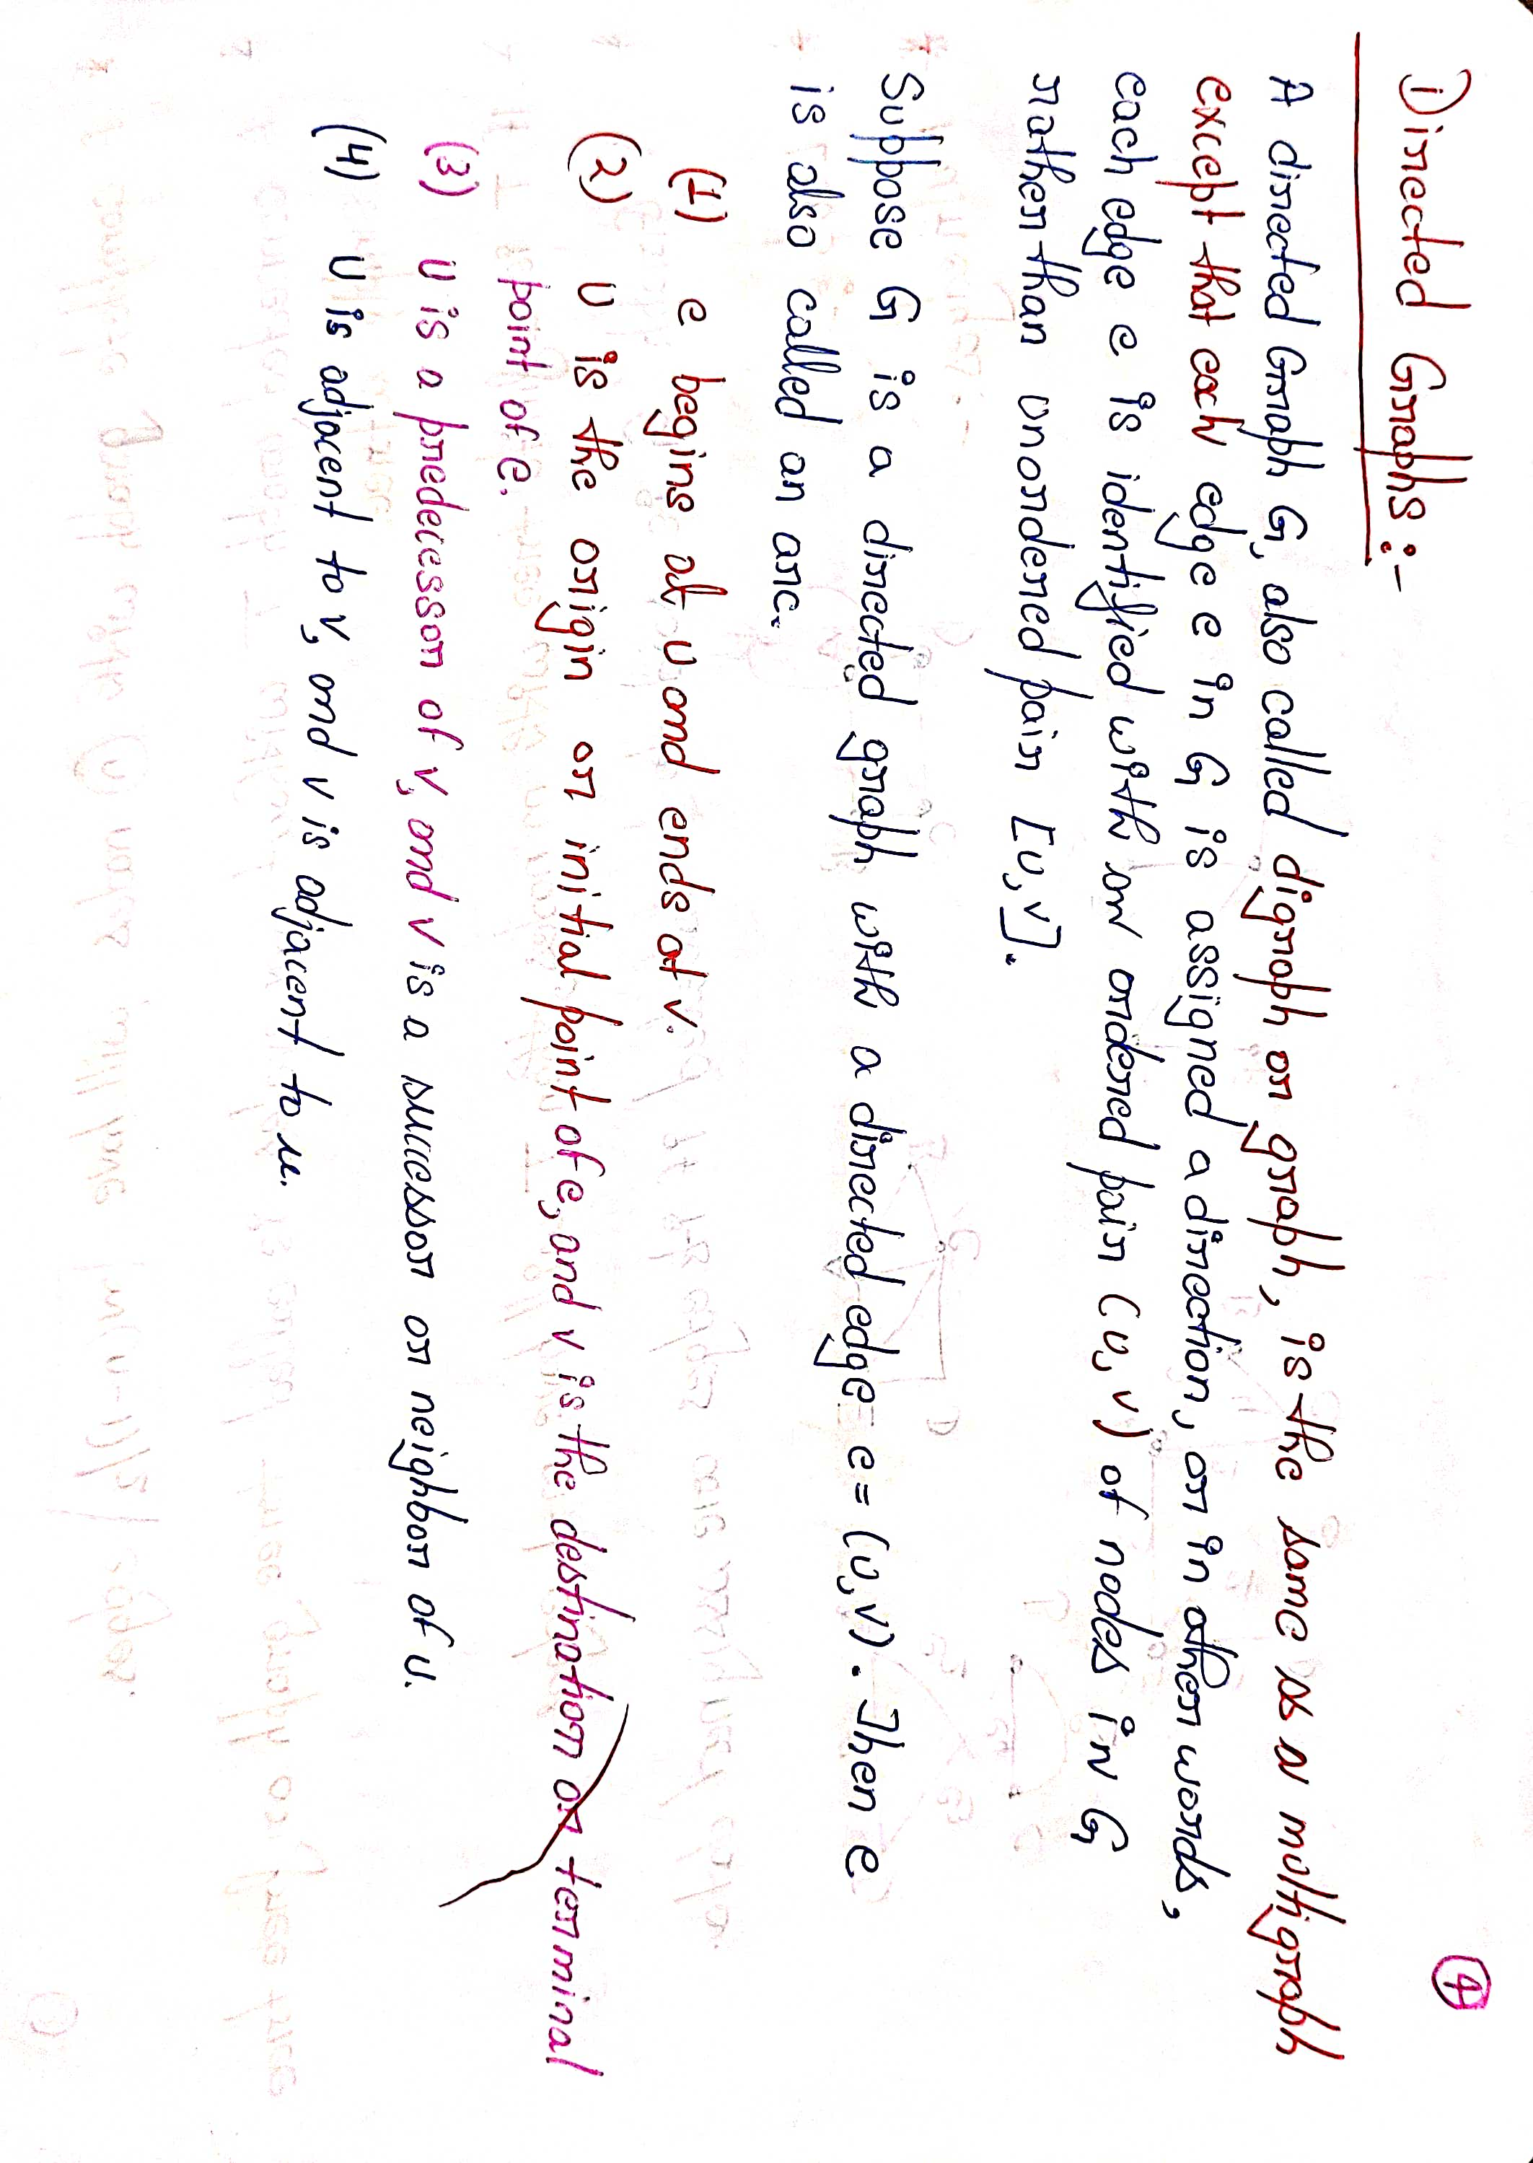

Slide 3
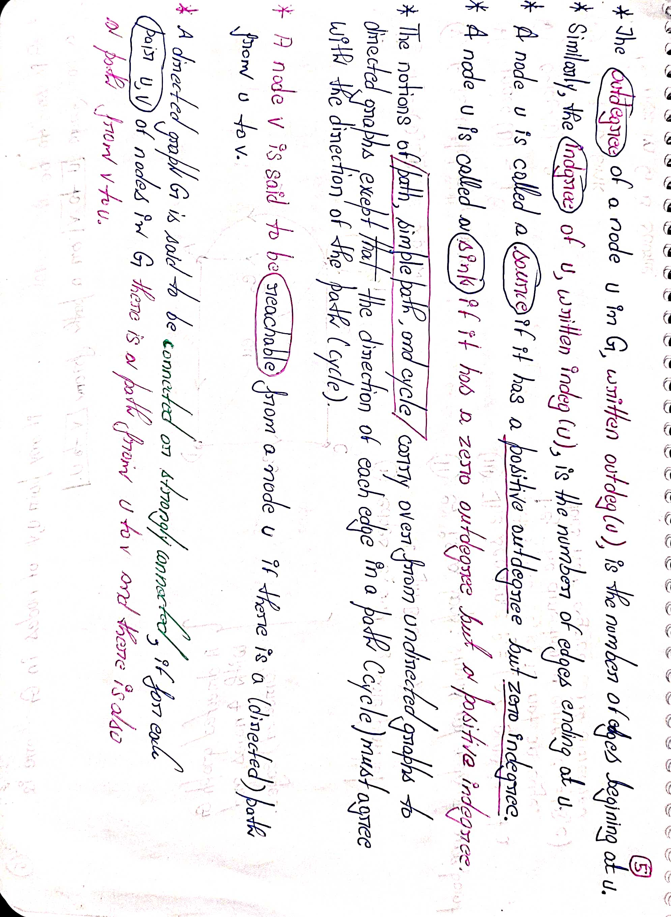

Slide 4
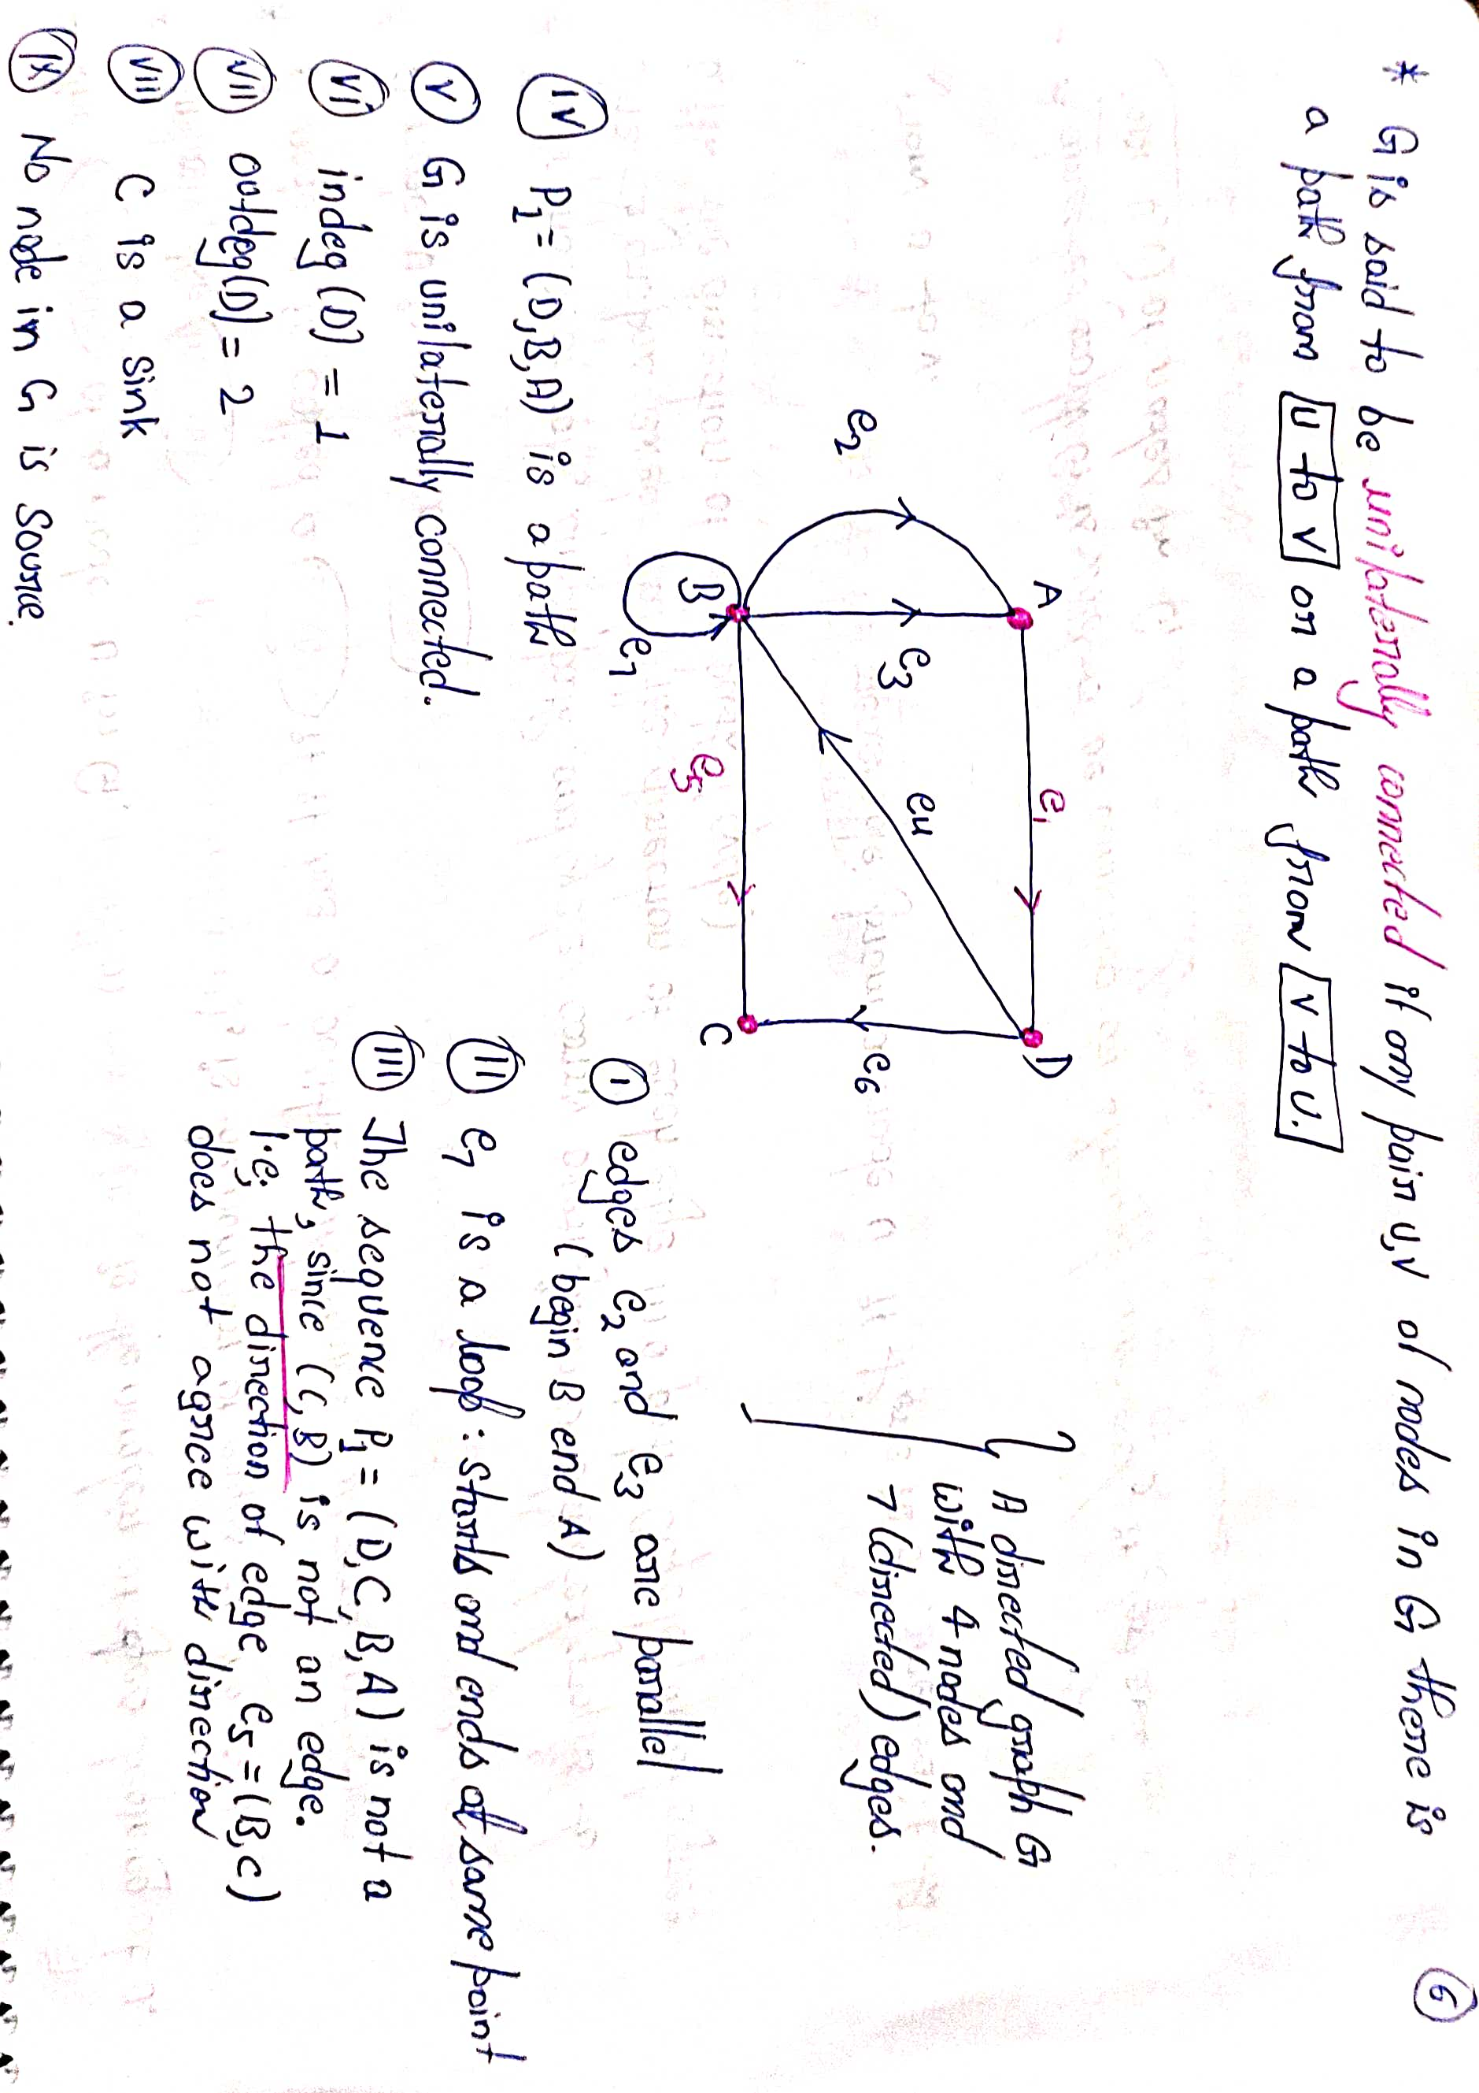

Slide 5
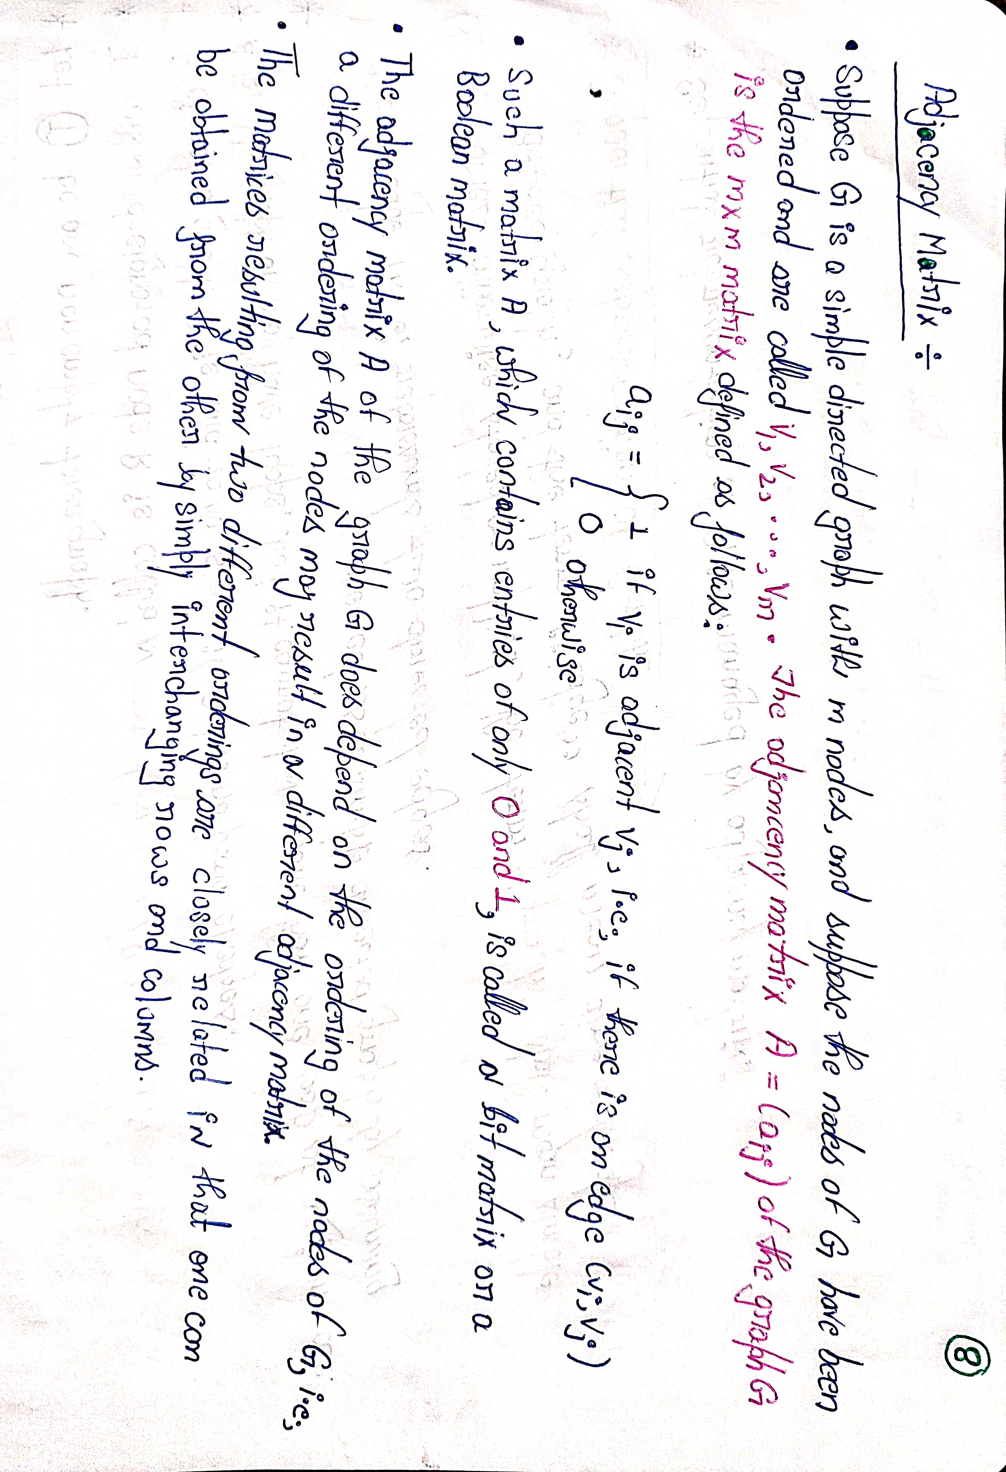

Slide 6
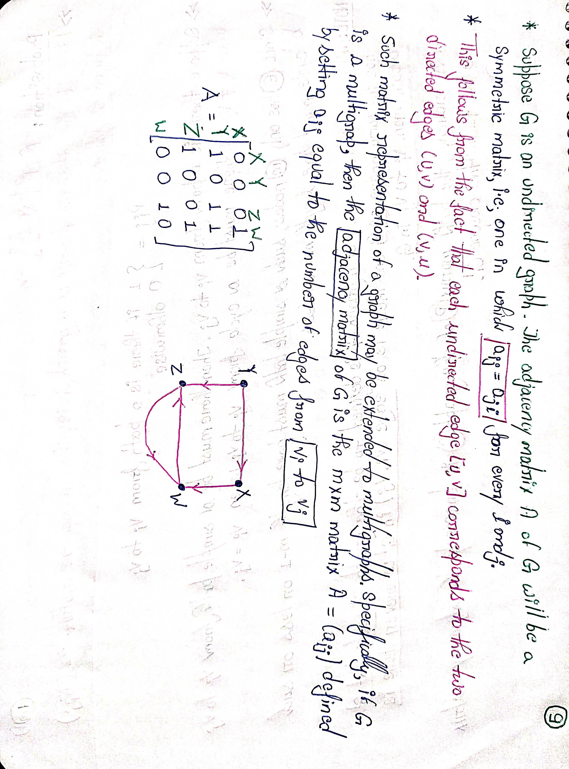
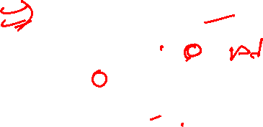

Slide 7
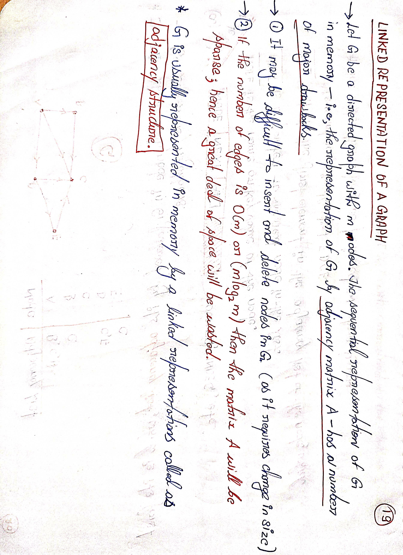

Slide 8
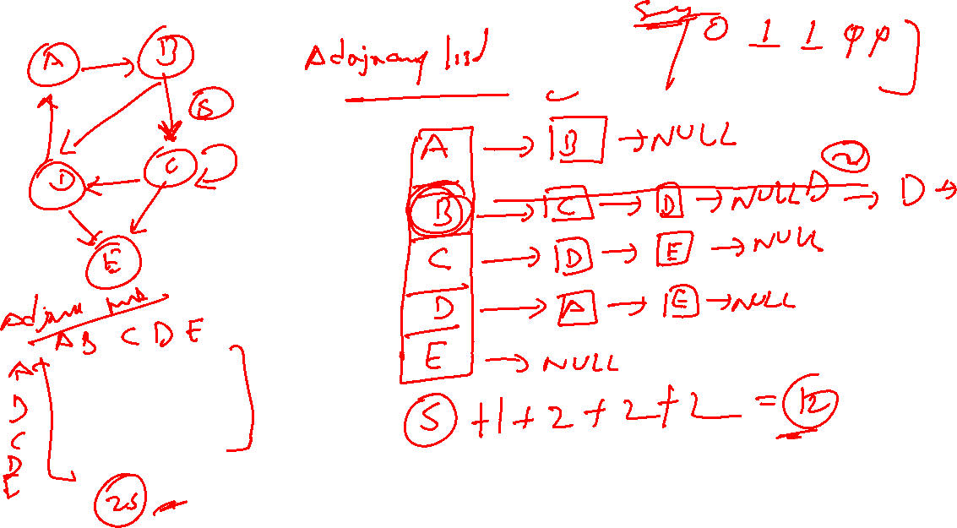

Slide 9
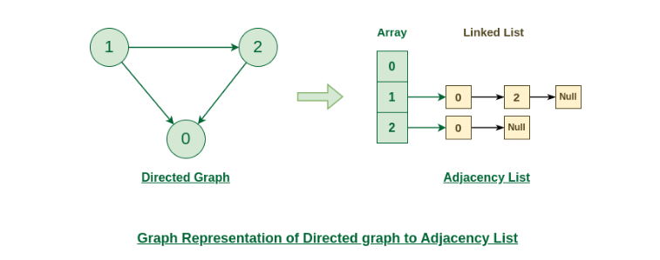
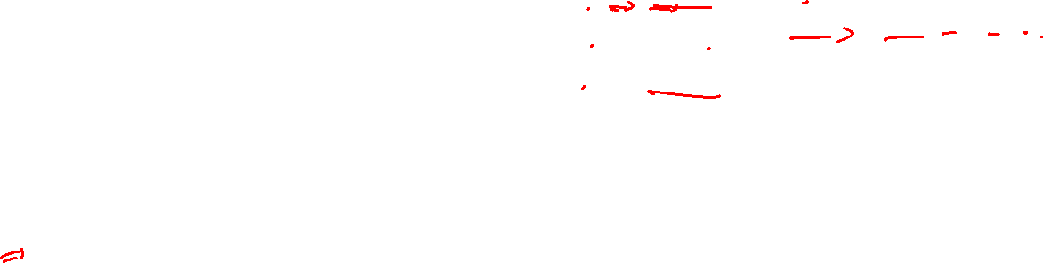
An adjacency list is a data structure used to represent a graph where each node in the graph stores a list of its neighboring vertices.
How to build an Adjacency List?
It is very easy and simple to construct an adjacency list for a graph there are certain steps given below that you need to follow:

Slide 10
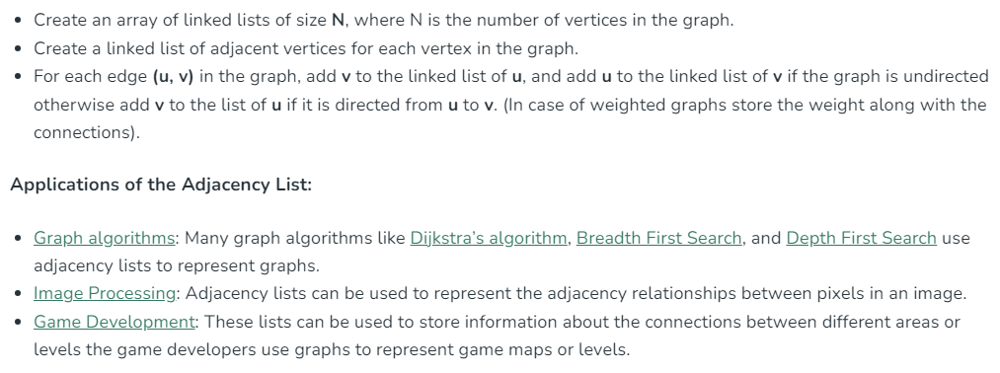


Slide 11
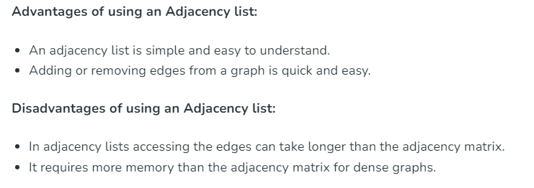

Slide 13
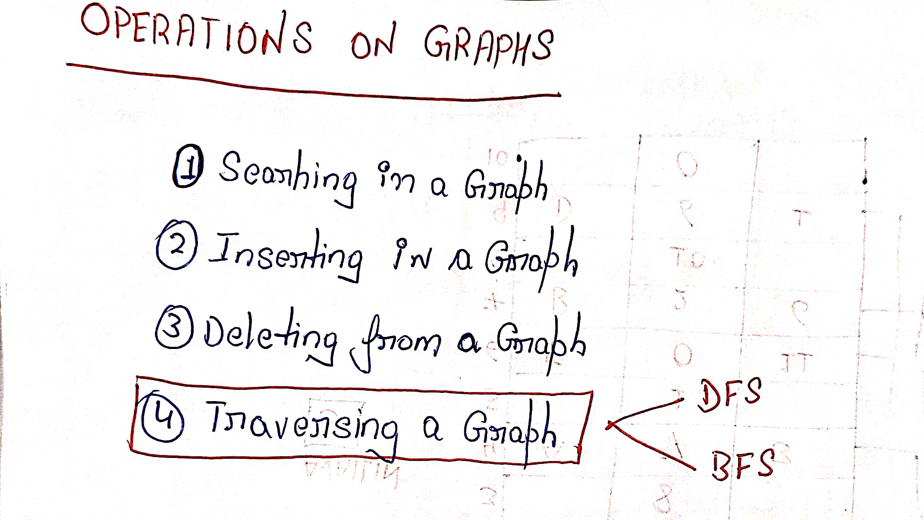
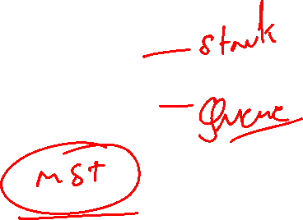

Slide 15
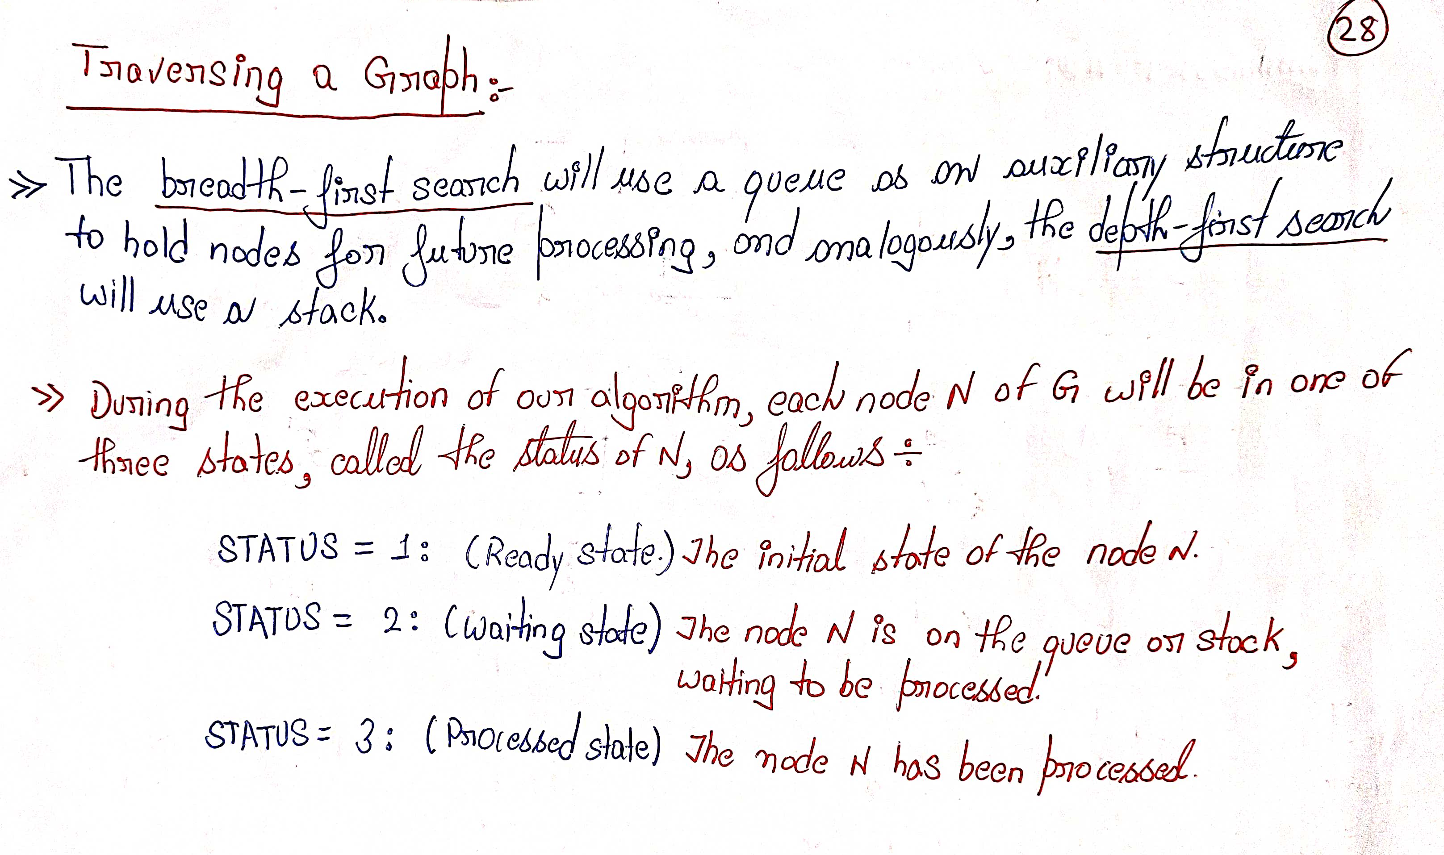
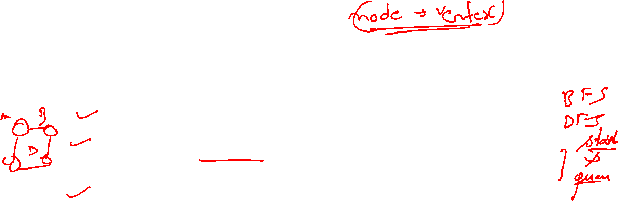

Slide 16
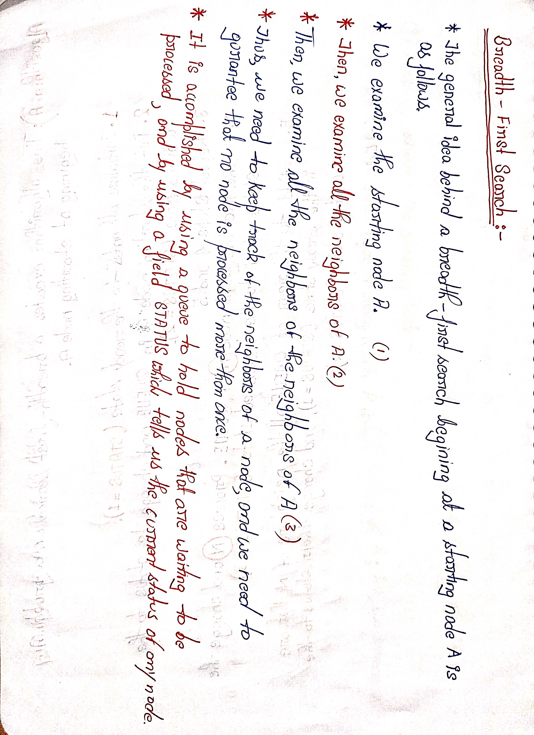
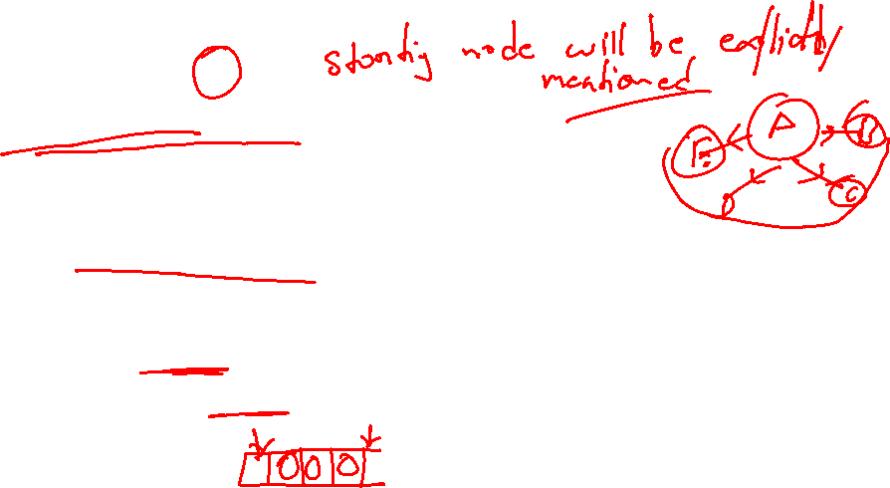

Slide 17
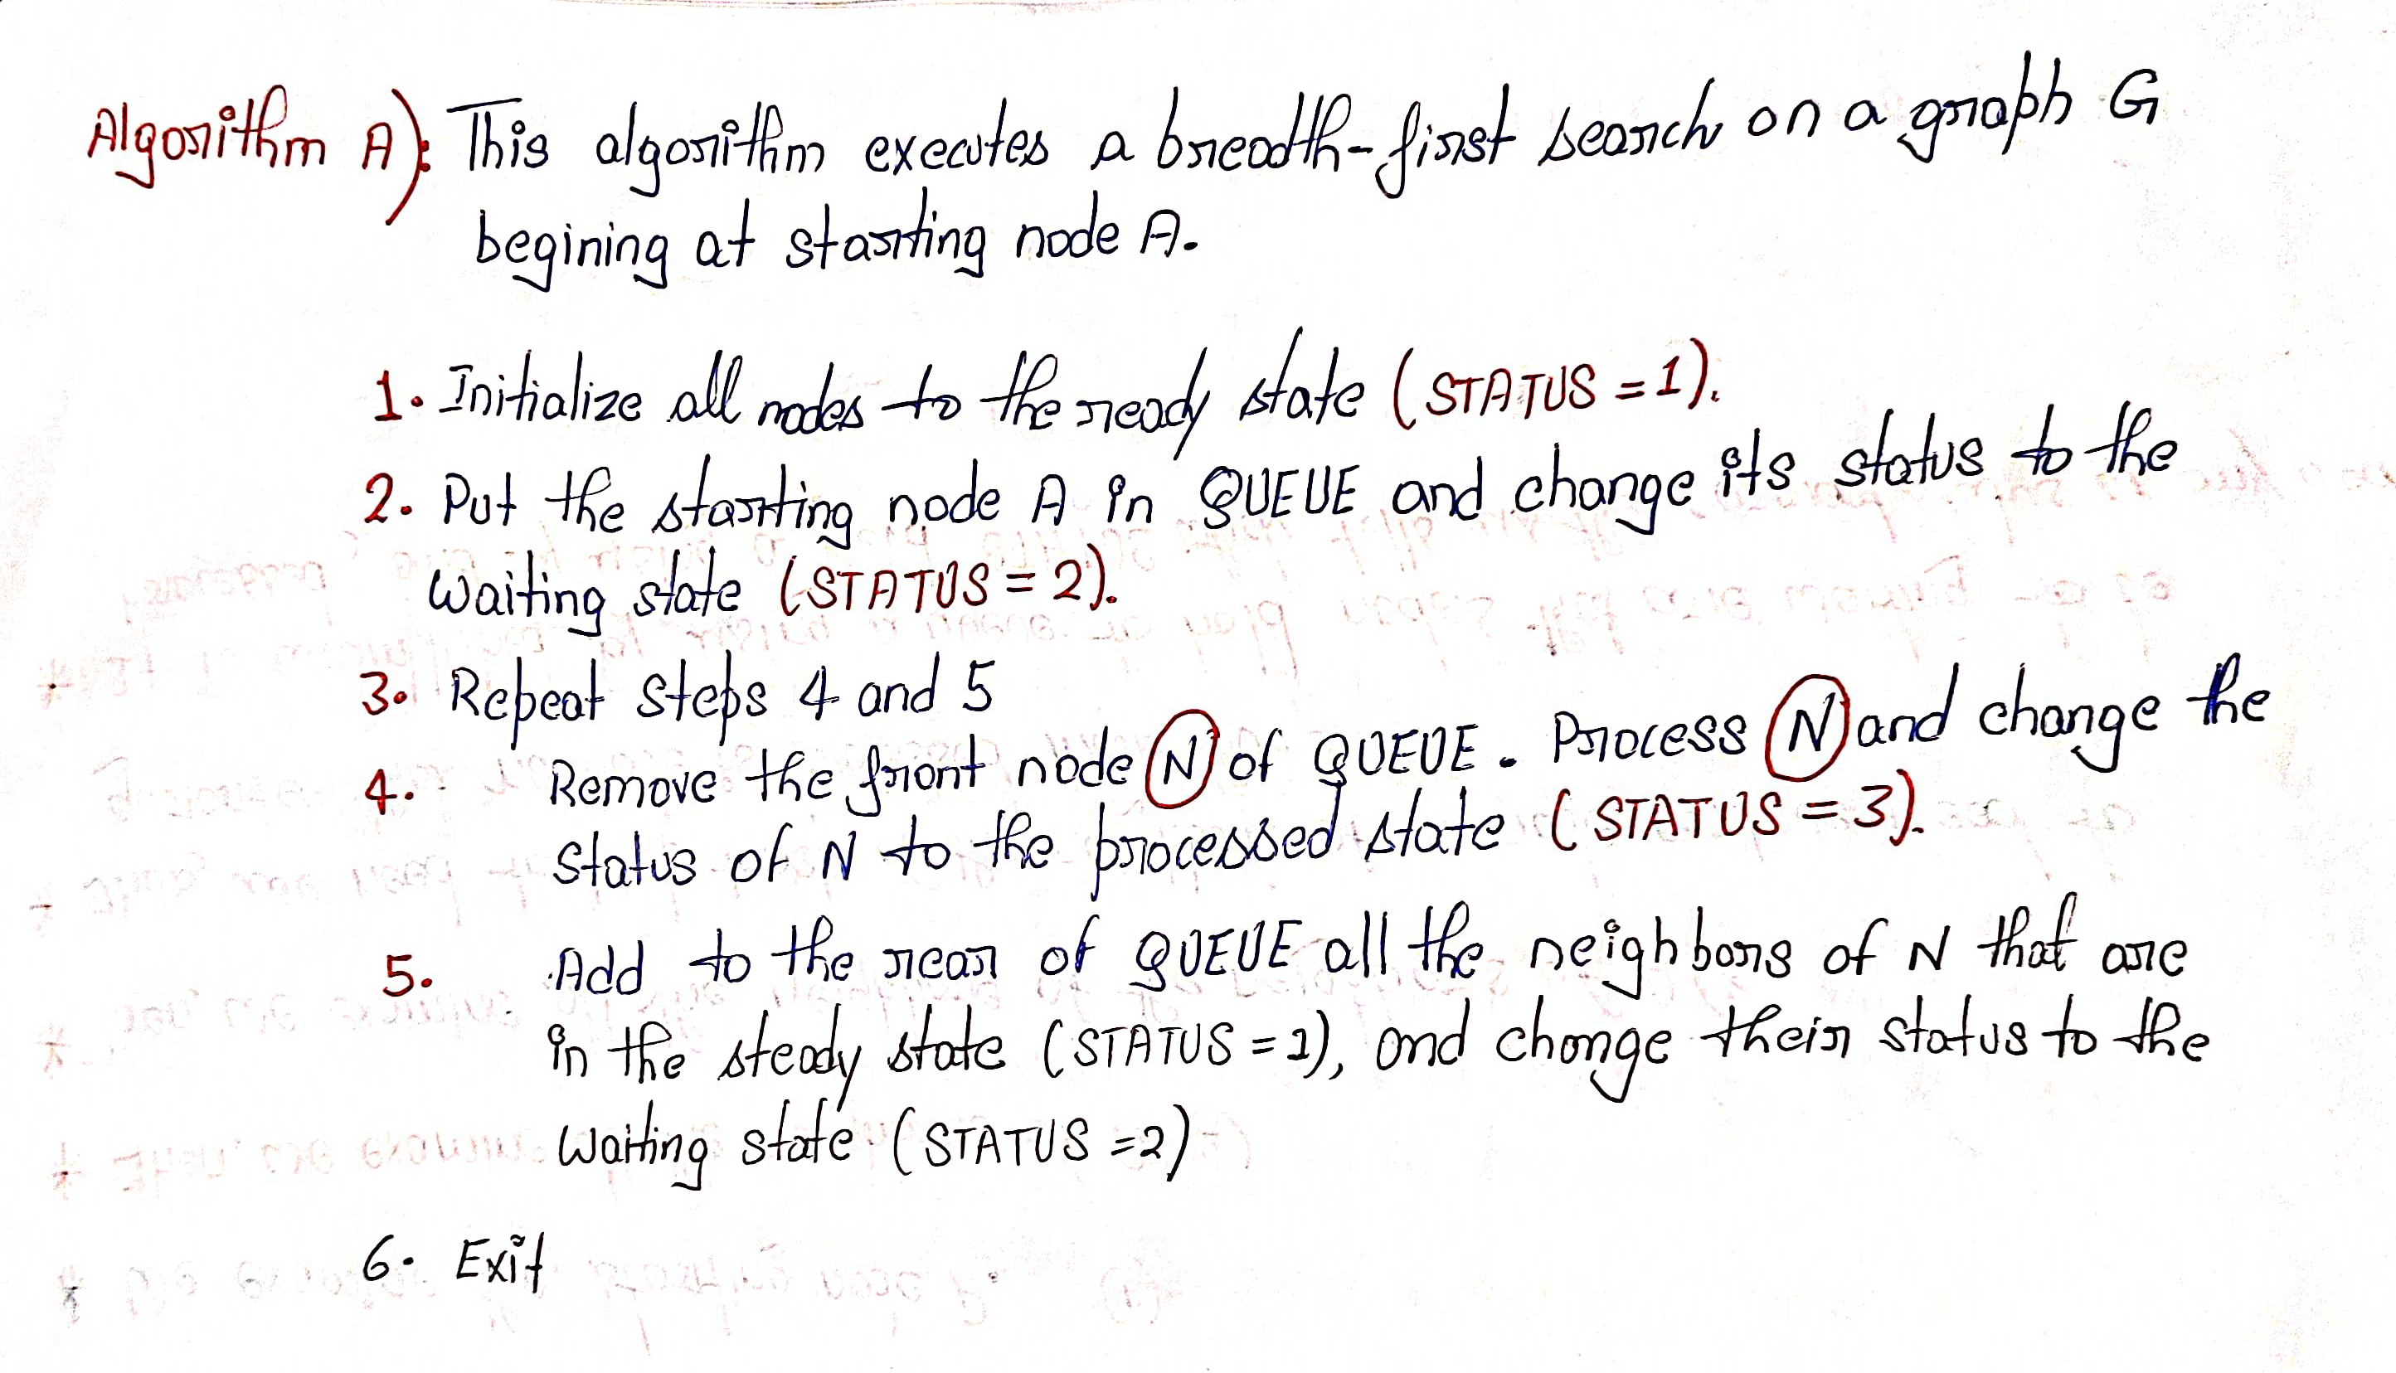

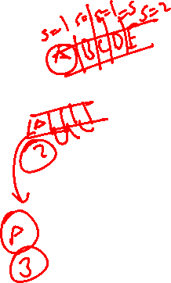

Slide 18
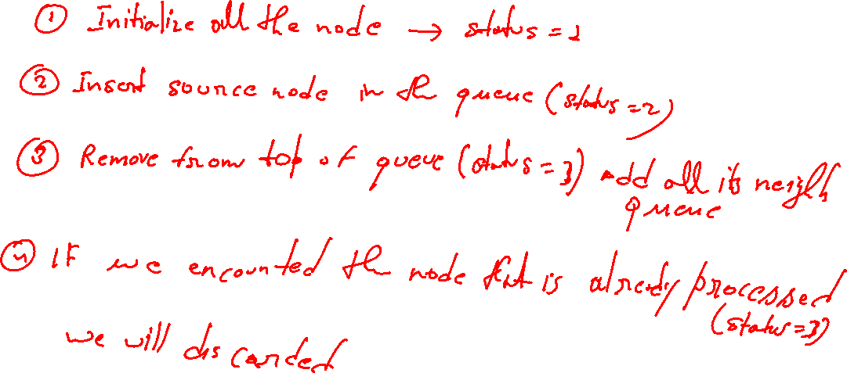

Slide 19
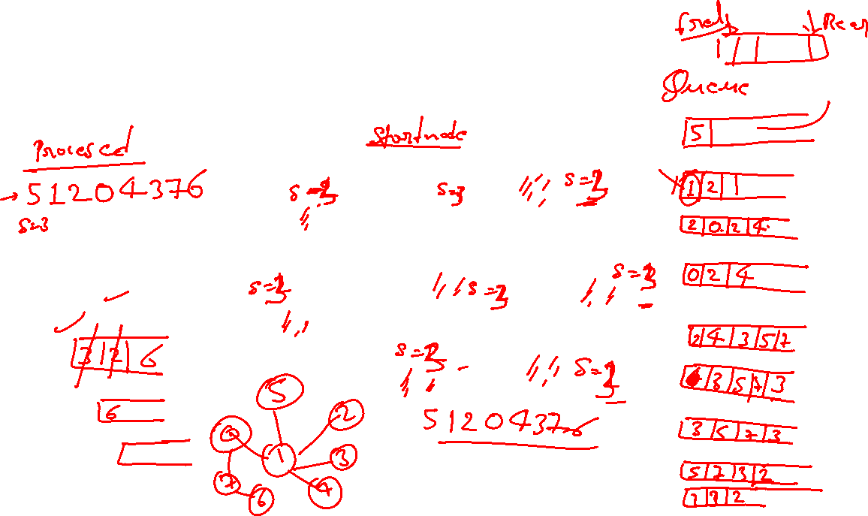
BFS: Start with Node 5
5
2
0
1
3
7
4
6
5

Slide 20
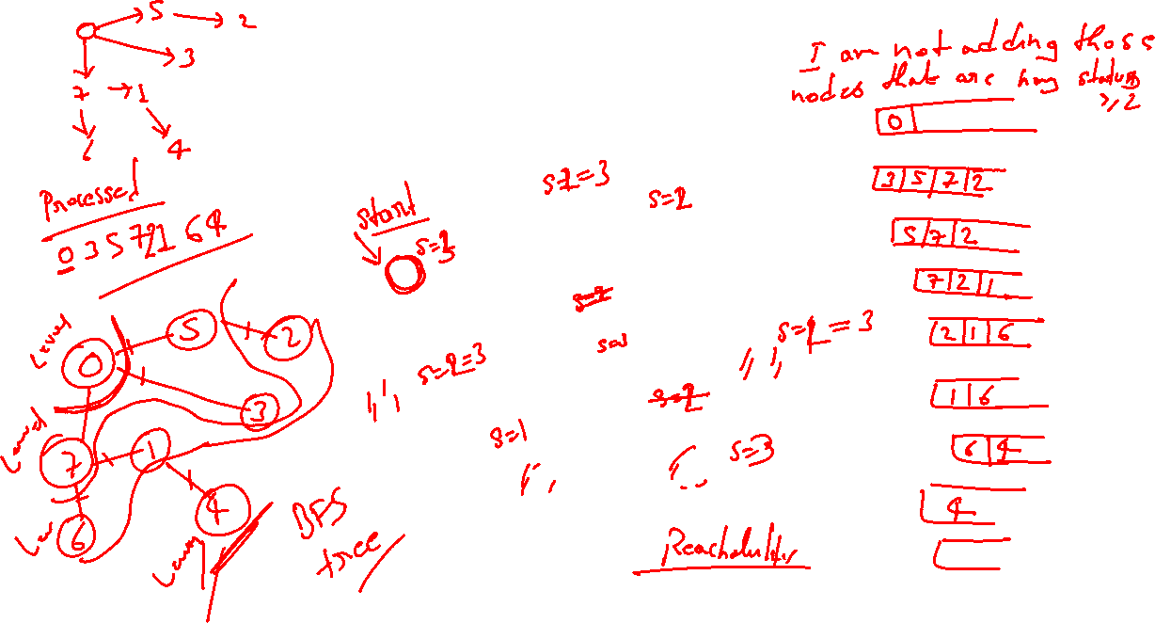
BFS: Node one-away
5
2
0
1
3
7
4
6
5

Slide 21
BFS: Visit 1 and 2
5
2
0
1
3
7
4
6
5 1 2

Slide 22
BFS: Nodes two-away
5
2
0
1
3
7
4
6
5 1 2

Slide 23

BFS: Visit 0 and 4
5
2
0
1
3
7
4
6
5 1 2 0 4

Slide 24
BFS: Nodes three-away
5
2
0
1
3
7
4
6
5 1 2 0 4

Slide 25
BFS: Visit nodes 3 and 7
5
2
0
1
3
7
4
6
5 1 2 0 4 3 7

Slide 26
BFS: Node four-away
5
2
0
1
3
7
4
6
5 1 2 0 4 3 7

Slide 27
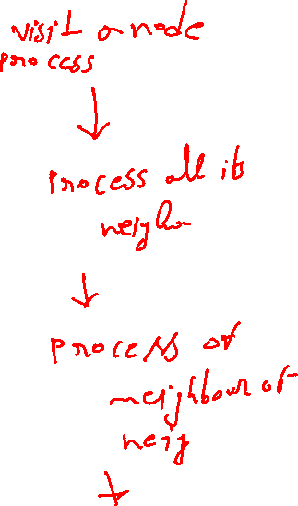
BFS: Visit 6
5
2
0
1
3
7
4
6
5 1 2 0 4 3 7 6

Slide 28
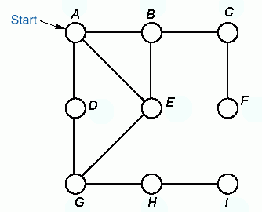

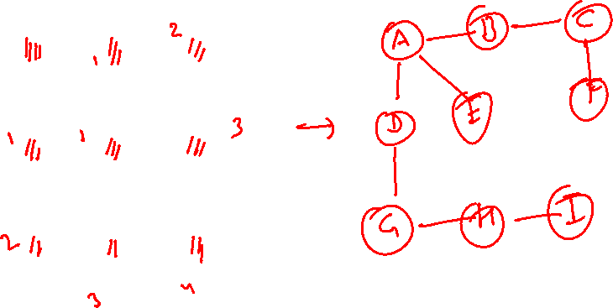
Example of BFS
BFS-tree:
Order of
Traversal
A B D E C G F H I

Slide 29
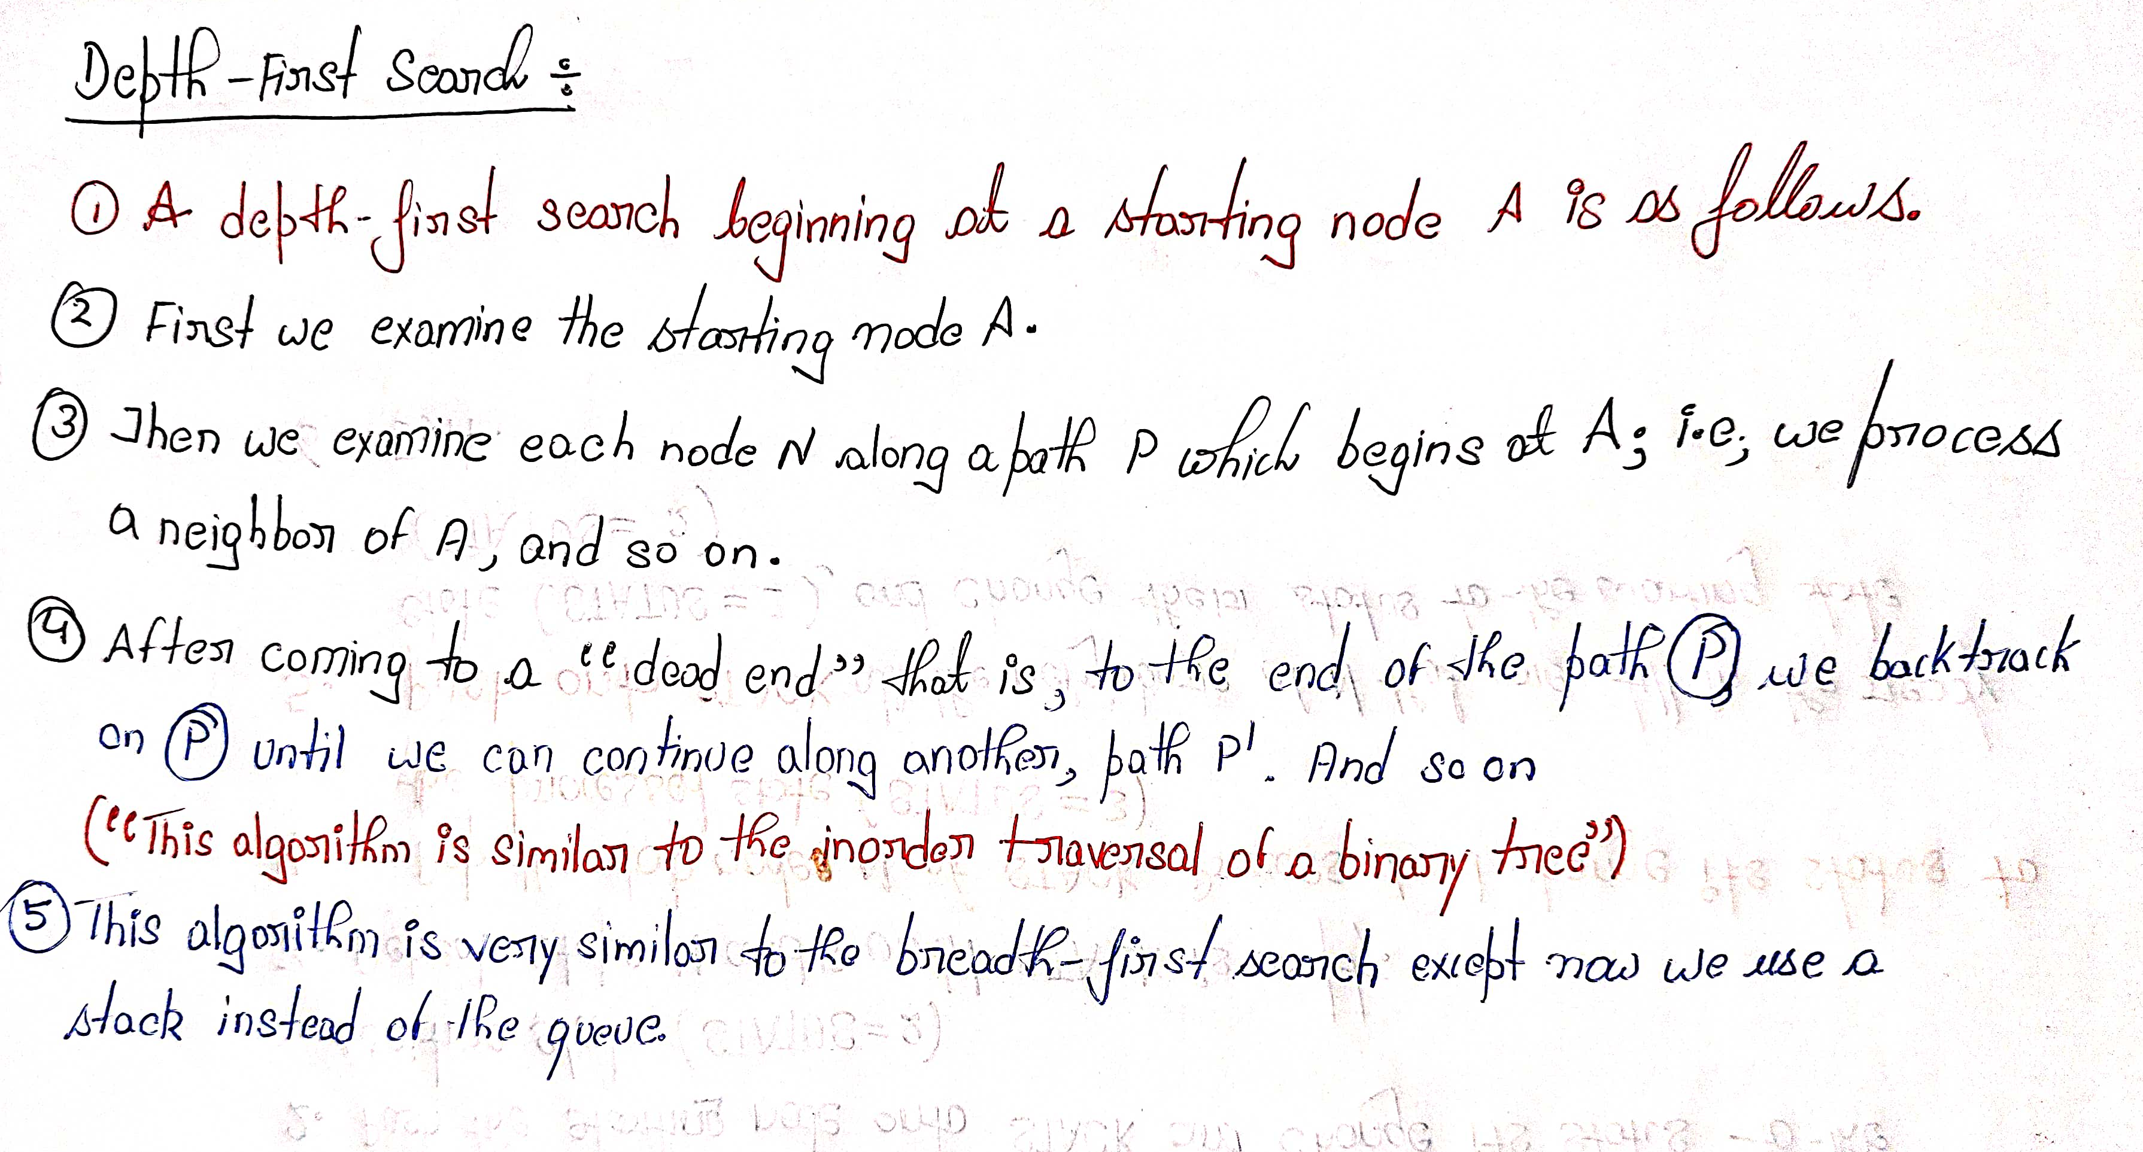

Slide 30
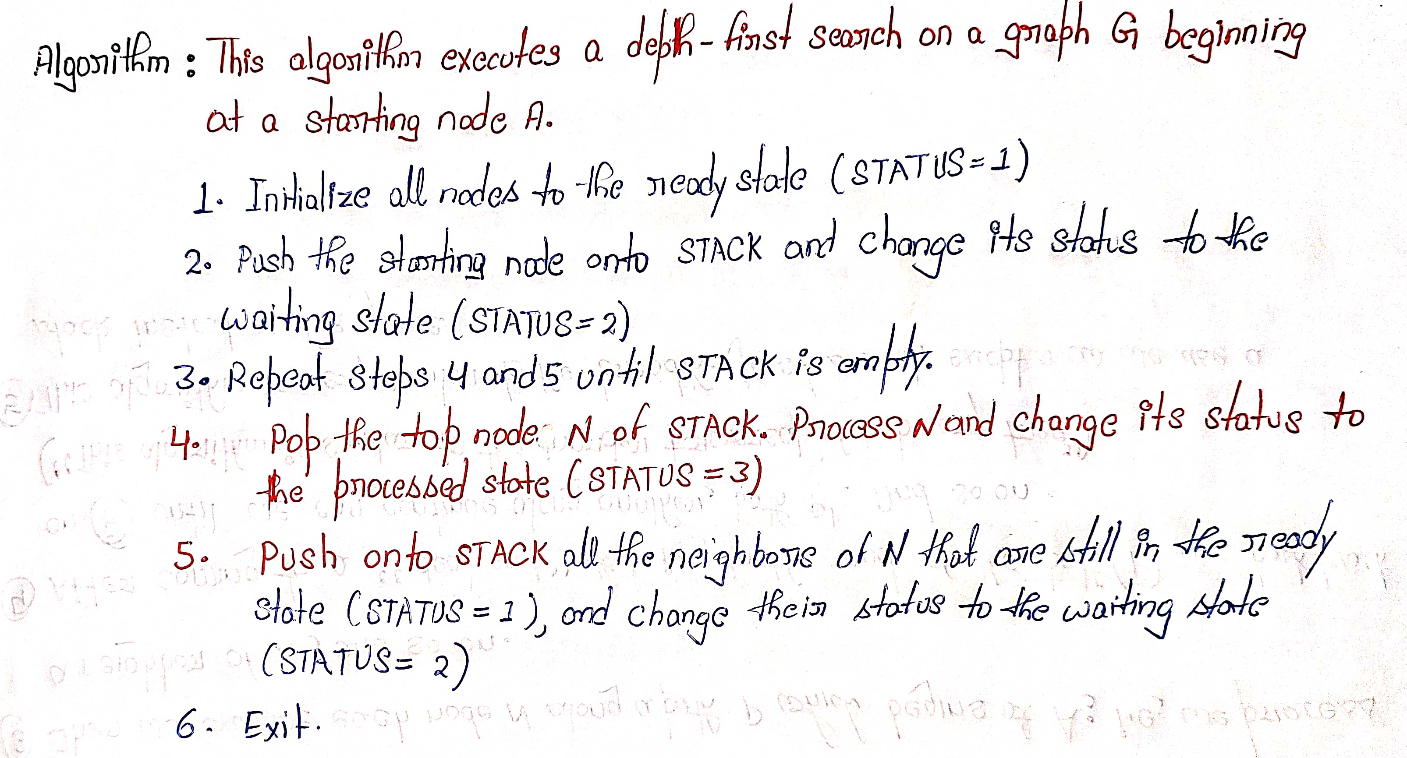
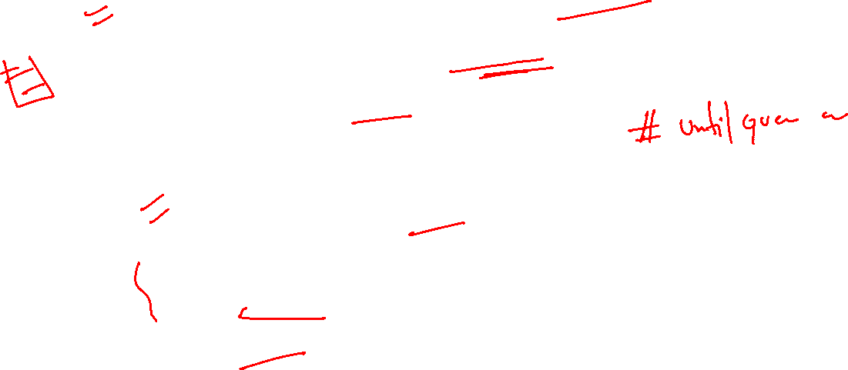

Slide 31
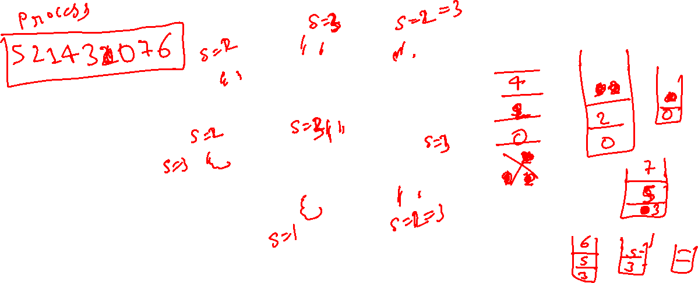
DFS: Start with Node 5
5
5
2
0
1
3
7
4
6
Push 5

Slide 32
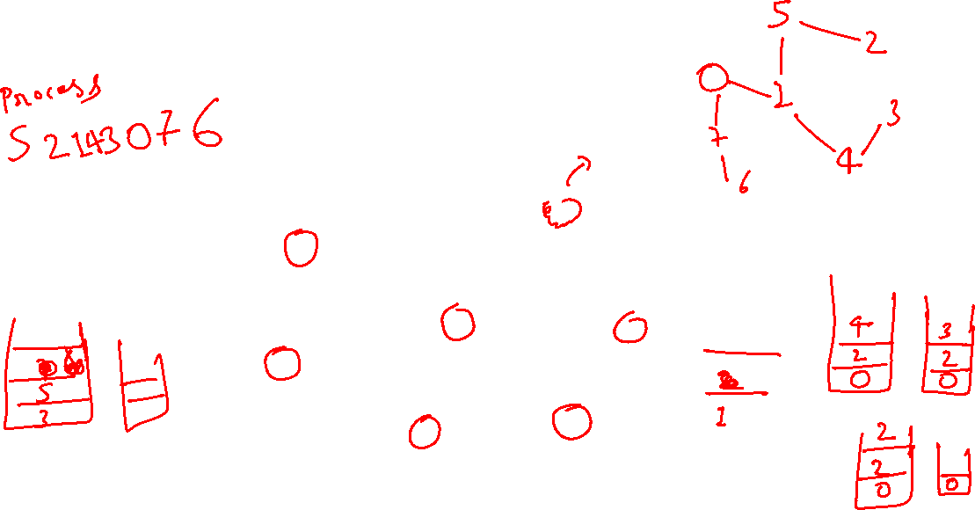
5
2
0
1
3
7
4
6
Pop/Visit/Mark 5
5

Slide 33
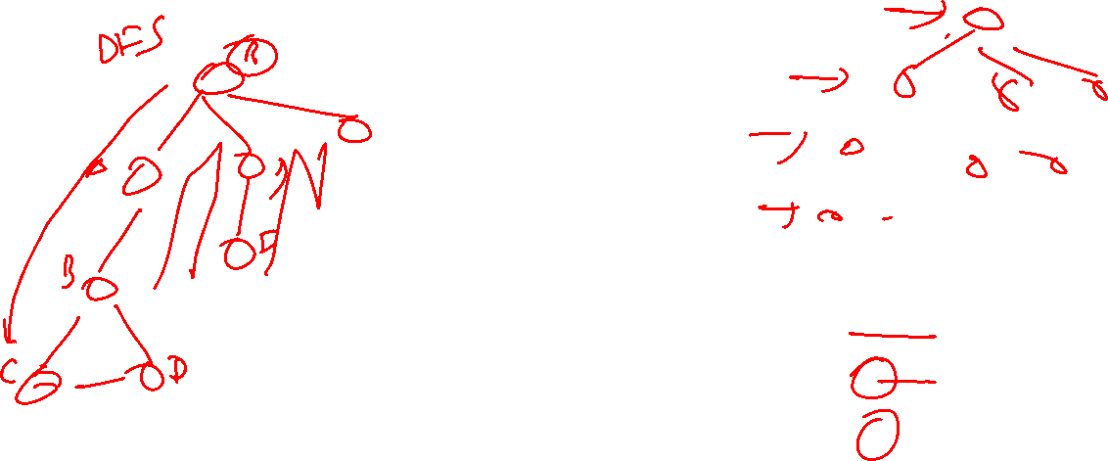
1
2
5
2
0
1
3
7
4
6
Push 2, Push 1
5

Slide 34
2
5
2
0
1
3
7
4
6
Pop/Visit/Mark 1
5 1

Slide 35
0
2
4
2
5
2
0
1
3
7
4
6
Push 4, Push 2, Push 0
5 1

Slide 36
2
4
2
5
2
0
1
3
7
4
6
Pop/Visit/Mark 0
5 1 0

Slide 37
3
7
2
4
2
5
2
0
1
3
7
4
6
Push 7, Push 3
5 1 0

Slide 38
7
2
4
2
5
2
0
1
3
7
4
6
Pop/Visit/Mark 3
5 1 0 3

Slide 39
2
7
2
4
2
5
2
0
1
3
7
4
6
Push 2
5 1 0 3

Slide 40
7
2
4
2
5
2
0
1
3
7
4
6
Pop/Mark/Visit 2
5 1 0 3 2

Slide 41
2
4
2
5
2
0
1
3
7
4
6
Pop/Mark/Visit 7
5 1 0 3 2 7

Slide 42
6
2
4
2
5
2
0
1
3
7
4
6
Push 6
5 1 0 3 2 7

Slide 43
2
4
2
5
2
0
1
3
7
4
6
Pop/Mark/Visit 6
5 1 0 3 2 7 6

Slide 44
4
2
5
2
0
1
3
7
4
6
Pop (don’t visit) 2
5 1 0 3 2 7 6

Slide 45
DFS: Start with Node 5
2
5
2
0
1
3
7
4
6
Pop/Mark/Visit 4
5 1 0 3 2 7 6 4

Slide 46
Preorder DFS: Start with Node 5
5
2
0
1
3
7
4
6
Pop (don’t visit) 2
5 1 0 3 2 7 6 4

Slide 47
Preorder DFS: Start with Node 5
5
2
0
1
3
7
4
6
Done
5 1 0 3 2 7 6 4

Slide 48
Problem: Laying Telephone Wire
Central office

Slide 49
Wiring: Naive Approach
Central office
Expensive!

Slide 50
Wiring: Better Approach
Central office
Minimize the total length of wire connecting the customers

